Slide 1
SVGMaps
WebDINO Canada Team

Slide 2
Outline
Updating SVGMap tutorials
New platform
Current progress
Future scope
LaWA (Layers as WebApps) for Canadian Data
Outlining the new layers
Demo

Slide 3


About the presenters
Ethan McIntyre
Web Developer @ WebDINO Japan
Jacob Lapish
UI/UX Designer @ WebDINO Japan

Slide 4
SVGMap / HLA
Documentation Redesign

Slide 5
Documentation Presentation Breakdown
Where We Started
The original MediaWiki-based tutorials
What We Changed
Docusaurus rebuild, Markdown, Multilingual support
What the Tutorial Covers
From static SVG maps to dynamic WebApp Layers
Why This Matters for HLA
Lowering the barrier for global contributors
We Want Your Feedback
Gaps, improvements, future language support

Slide 6
Where we Started
Format Challenges
Non-linear, hard to navigate layout
MediaWiki markup unfamiliar to modern devs
No consistent progressive structure
No built in version control or contribution workflow
Language Barrier
Written entirely in Japanese
Immediate barrier for non japanese devs
HLA is a W3C topic but inaccessible globally
Rich technical content hidden behind language and format

Slide 7
What We Changed
BEFORE - MediaWiki
MediaWiki markup & structure
Japanese only
No sidebar or progressive navigation
No version control / contribution flow
Unfamiliar to open source developers
AFTER - Docusaurus
Standard markdown making it easy to read and contribute
Japanese and English (Via Language Toggle)
Clean sidebar, progressive structure
Github native, open to community contributions
Same platform as React, MDX, and other major OSS

Slide 8
Bilingual Documentation
Language is a barrier to participation
Japanese (Native)
Original source language, maintained by core team
English (translated)
Fully translated, built-in language toggle in Docusaurus
Future Languages
Community contributions welcome with plans for global expansion - Future languages will be supported
HLA is a W3C community topic - its documentation should be accessible to the global web community

Slide 9
What The Tutorial Covers
A progressive path from zero to dynamic web mapping
Developer Path
Tutorials 1-4: Basics - static SVG maps, POI markers, bitmap overlays. No server or JS required
Tutorials 5-9: WebApp layers - OSM tile integration, zoom responsive display, dynamic data
Tutorials 10-15: Advanced - GeoJSON, CSV tile data, mesh geometry, combining live web services

Slide 10
Why This Matters for HLA
HLA was born from a real crisis, the inability to freely overlay maps from different organizations after the 1995 Great Hanshin Awaji Earthquake
HLA has run in real world systems for 15+ years and has been developed within W3C since the early days of SVG
The philosophy of decentralized, user controlled web mapping is compelling only if people can actually get started
A clean, accessible front door is as important as the technology itself for building a global contributor community
Docusaurus means the docs are open to pull requests and anyone can improve the tutorial, add examples, or translate

Slide 11
We Want Your Feedback
Help us make SVGMap / HLA more accessible to global contributors
What gaps do you notice?
Where does the tutorial break down? What prerequisite knowledge is assumed that shouldn’t be?
What could be simpler?
Are there concepts that could be explained more clearly, or steps that could be streamlined?
What would lower your barrier to contribute?
What would make you more likely to try SVGMap, add a layer, or submit a PR?
What languages should we add next?
We have Japanese and English. Where should we go from here?
What's your experience as a newcomer?
First impressions matter. We want to know what the onboarding experience actually feels like.

Slide 12
Open to the World
The goal of this documentation work is the same as the goal of HLA:
Openness, accessibility, and the ability for anyone to participate

Slide 13
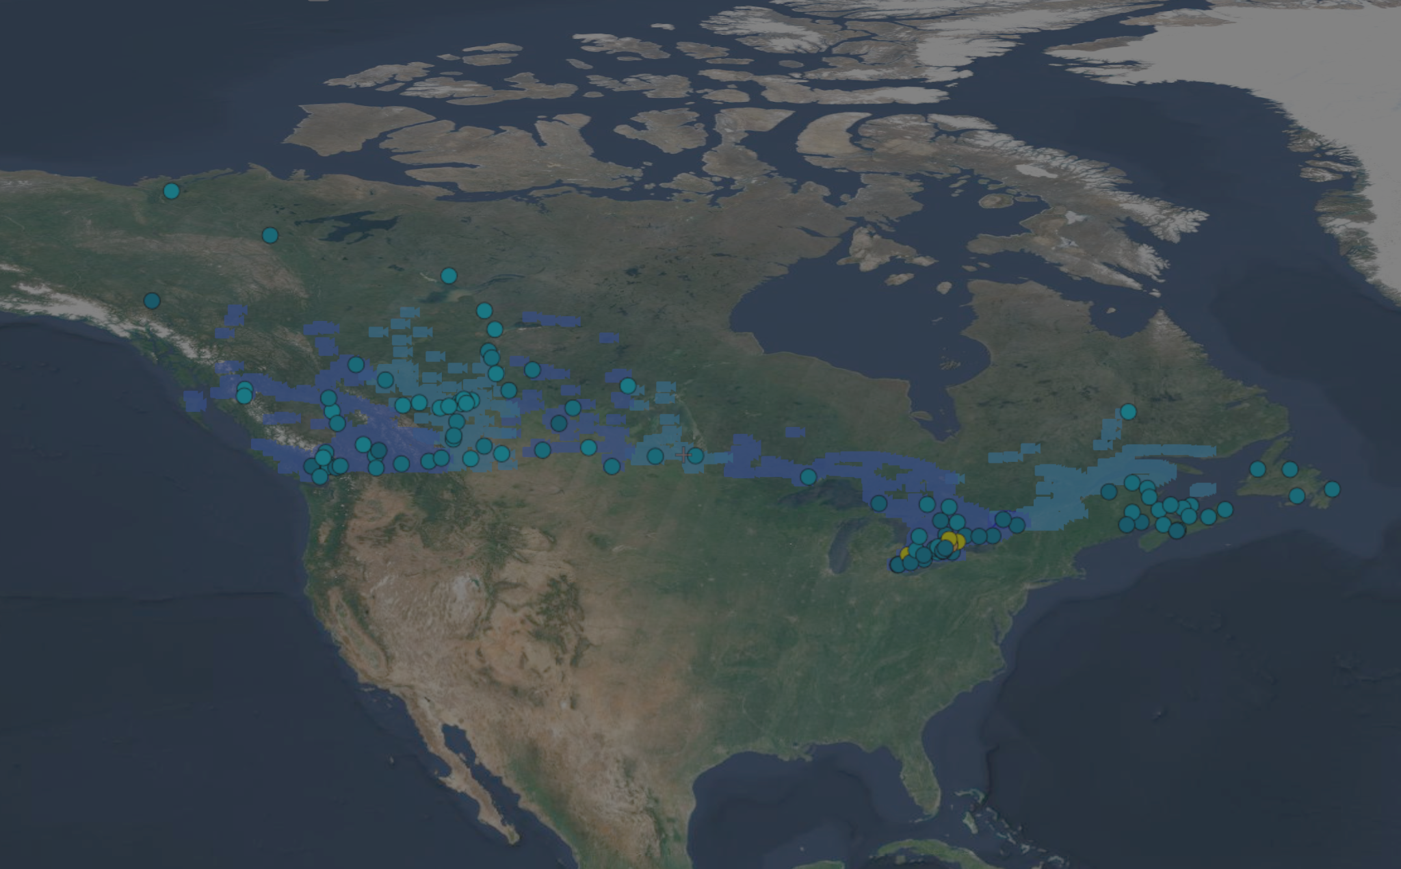
LaWA for Canadian mapping data

Slide 14
Purpose
Expanding use-cases of LaWA (Layers as WebApps) beyond Japan
Building an international community
Supported by documentation internationalization efforts
Canada – familiarity of available data and practical applications

Slide 15
Canadian Layers
Created new layers with public data
Live Traffic Camera feeds
Canadian Provinces
Alberta, British Columbia, Manitoba, Ontario, Quebec, and Saskatchewan
City of Ottawa
Air Quality
Nationwide data from Environment and Climate Change Canada
Trail and path data from the NCC (National Capital Commission)

Slide 16
Demo Outline
Displaying map data managed by different provinces simultaneously
Traffic cameras from 6 different provinces
Overlapping data from different levels of government
NCC (Federal), Ontario 511 (Provincial), City of Ottawa (Municipal)
Map interactivity
AQHI (Air Quality Health Index) API from Environment and Climate Change Canada
Exploring observed AQHI within the past 24 hours

Slide 17
Canada Layers Demo

Slide 18
Thank you for listening!

